Slide 1
FINAL PROJECT
Design of 2-to-4 and 3-to-8 Decoders Using Logic Gates
DECODER
DESIGN
S4 / S12 • Final Project Presentation
TEAM MEMBERS
2620030064 — Deethya Reddy
2620030069 — Aman Kumar Shah
Digital Logic Design
Logisim Demonstration
2620030077 — Maroju Venkata Sairam Harsha
2620030091 — Katrenikona Lakshmi Harshitha
Project focus: logic • circuit design • simulation • applications

Slide 2
Introduction and Objective
A decoder converts a binary input code into one active output line.
WHAT IS A DECODER?
PROJECT OBJECTIVES
• A combinational logic circuit with n input bits and up to 2ⁿ output lines.
• For each valid input combination, one output is HIGH (1) and the others are LOW (0).
• The outputs represent the binary value of the input.
• A decoder can be built from NOT, AND and enable logic.
Decoder
2-bit input
4 outputs
• Design a 2-to-4 decoder using logic gates.
• Extend the idea to a 3-to-8 decoder.
• Verify all input combinations in Logisim.
2

Slide 3
Theory and Logic Circuit
2-to-4 decoder: two inputs select exactly one of four outputs.
BOOLEAN EXPRESSIONS
LOGIC STRUCTURE (CONCEPTUAL)
Y₀ = A̅B̅
NOT
AND
Y0 = A̅B̅
A
A̅
Y₁ = A̅B
AND
Y1 = A̅B
Y₂ = AB̅
NOT
B
B̅
AND
Y2 = AB̅
Y₃ = AB
AND
Y3 = AB
A̅ and B̅ are produced using NOT gates. Each output is an AND of one unique input combination.
The same principle scales to 3 inputs and 8 minterms.
3

Slide 4
Circuit Design in Logisim
Build each output from the required input literals using NOT and AND gates.
2-TO-4 DECODER BUILD
3-TO-8 DECODER BUILD
• 1. Place two input pins: A and B.
• 2. Use NOT gates to create A̅ and B̅.
• 3. Place four 2-input AND gates.
• 4. Wire the four combinations to Y₀–Y₃.
• 5. Add output pins/LEDs and toggle A, B.
• 1. Place three input pins: A, B and C.
• 2. Create A̅, B̅ and C̅ with NOT gates.
• 3. Use eight 3-input AND gates (or equivalent gates).
• 4. Connect one minterm to each output Y₀–Y₇.
• 5. Test all 8 combinations from 000 to 111.
4

Slide 5
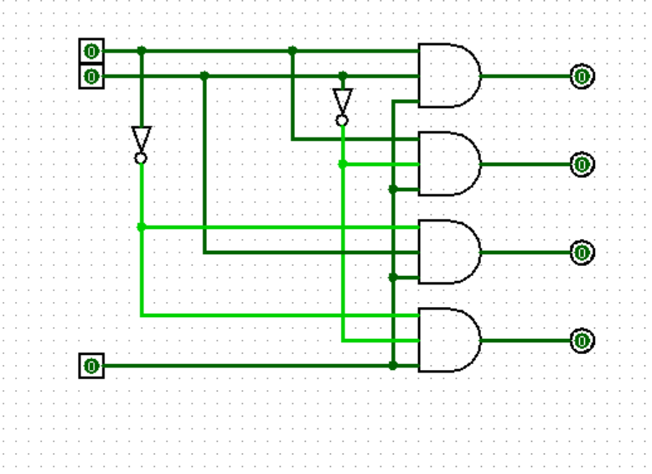
2-4 DECODER:

Slide 6
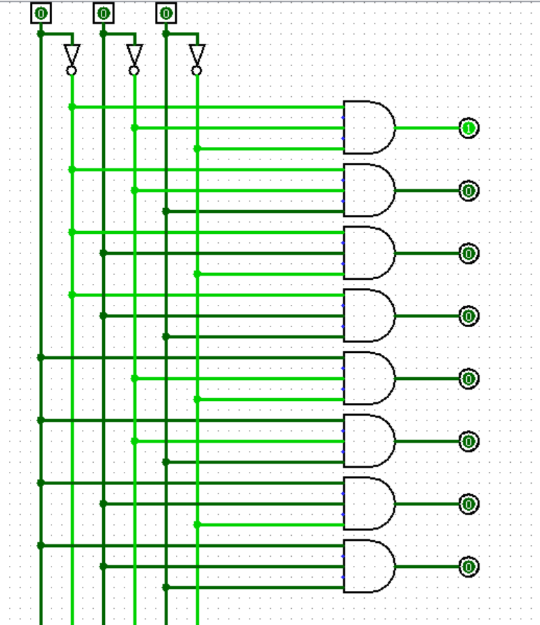
3-8 DECODER

Slide 7
Simulation Results and Truth Tables
Expected outputs for active-HIGH decoders; use these tables to verify the Logisim circuit.
2-TO-4 DECODER
3-TO-8 DECODER
A | B | Y₀ | Y₁ | Y₂ | Y₃
0 | 0 | 1 | 0 | 0 | 0
0 | 1 | 0 | 1 | 0 | 0
1 | 0 | 0 | 0 | 1 | 0
1 | 1 | 0 | 0 | 0 | 1
A | B | C | Active output
0 | 0 | 0 | Y₀ = 1
0 | 0 | 1 | Y₁ = 1
0 | 1 | 0 | Y₂ = 1
0 | 1 | 1 | Y₃ = 1
1 | 0 | 0 | Y₄ = 1
1 | 0 | 1 | Y₅ = 1
1 | 1 | 0 | Y₆ = 1
1 | 1 | 1 | Y₇ = 1
Check: exactly one output is 1 for every input pair.
All other outputs remain 0.
5

Slide 8
Conclusion and Applications
Decoders are simple building blocks used to select one destination or device.
CONCLUSION
APPLICATIONS
• A 2-to-4 decoder maps 2 input bits to 4 outputs.
• A 3-to-8 decoder maps 3 input bits to 8 outputs.
• NOT and AND gates implement the required minterms.
• Truth-table testing confirms one active output for each valid input.
• Memory address and I/O device selection.
• Instruction decoding in processors.
• Seven-segment display and control systems (with suitable logic).
• Digital communication and data routing.
• Thank you •
6

